Slide 1
Font Detection
Ran Liu, Nolan Chen, Yuchen Wang

Slide 2
MOTIVATION
Saw other people’s posters have fancier font than yours?
Want to get fonts used by others?
Want a set of fonts of your own?

Slide 3
BACKGROUND INFORMATION
Modules we used:
Tesseract -> Pytesseract
numpy
openCV
skimage
scipy

Slide 4
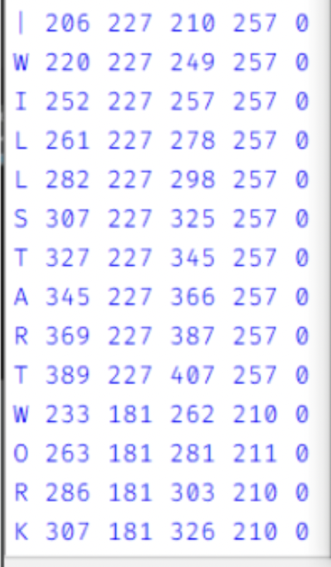
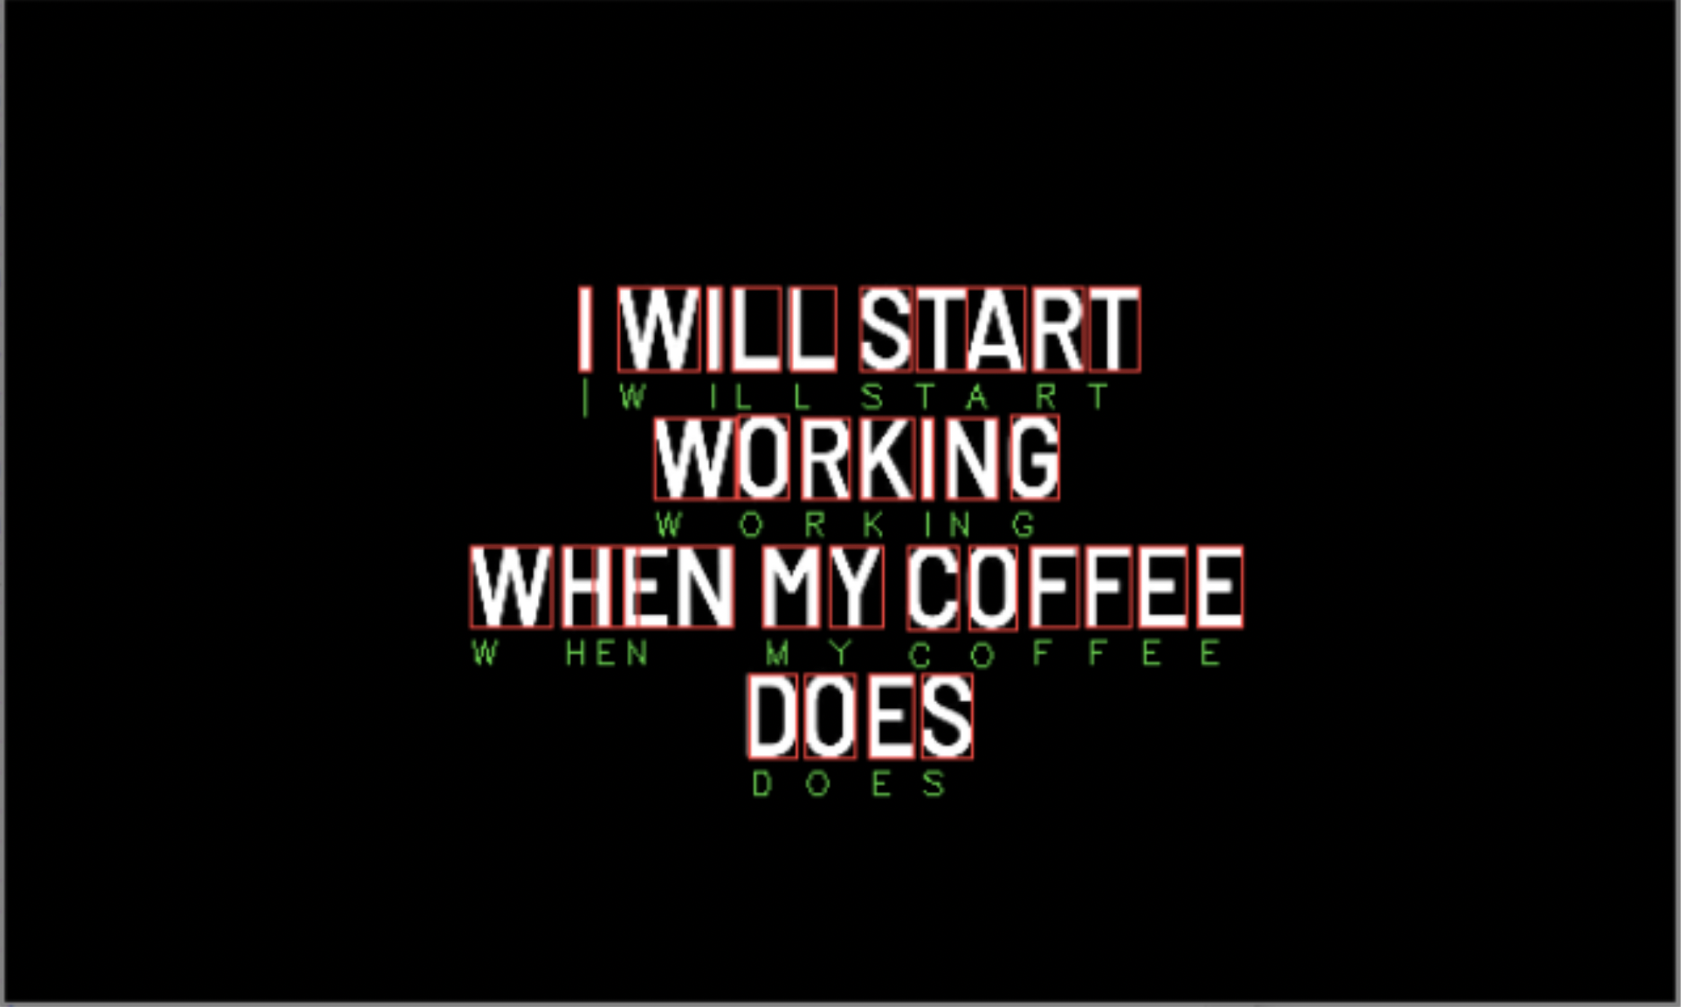
pytesseract Tesseract-OCR Engine
Wrapper
recognize and “read” the text embedded in images
extract text from images and documents without a text layer
pytesseract.image_to_string(img2,config=custom_config) pytesseract.image_to_boxes(image)

Slide 5
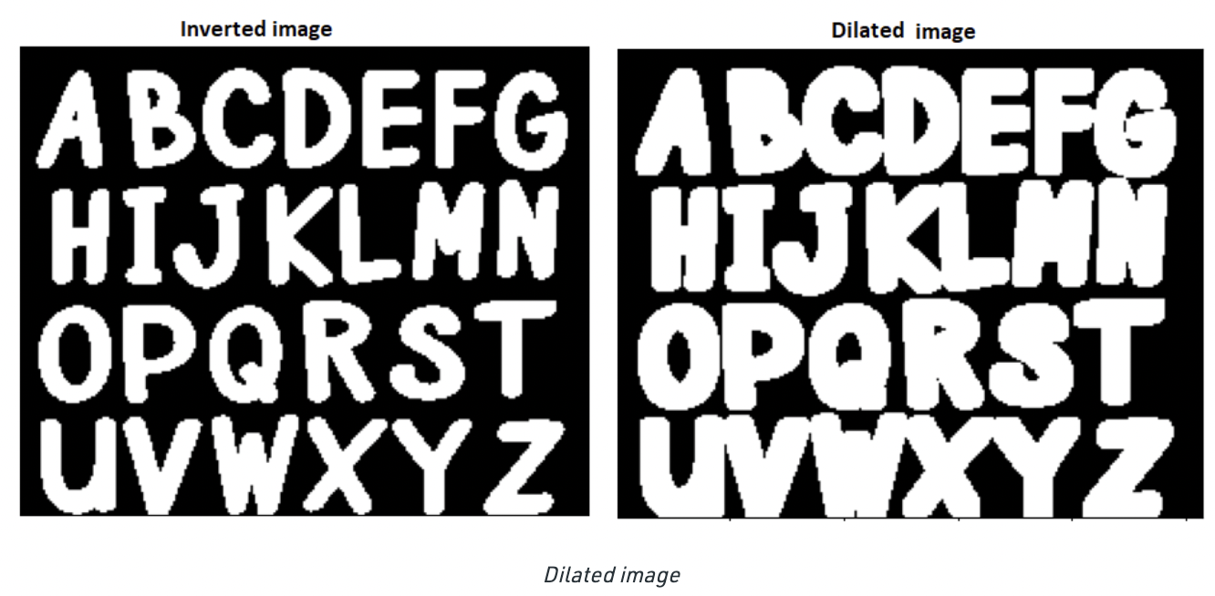
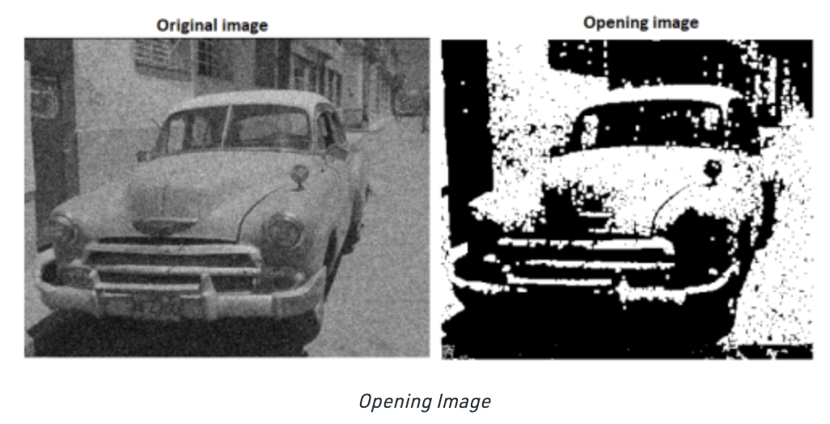
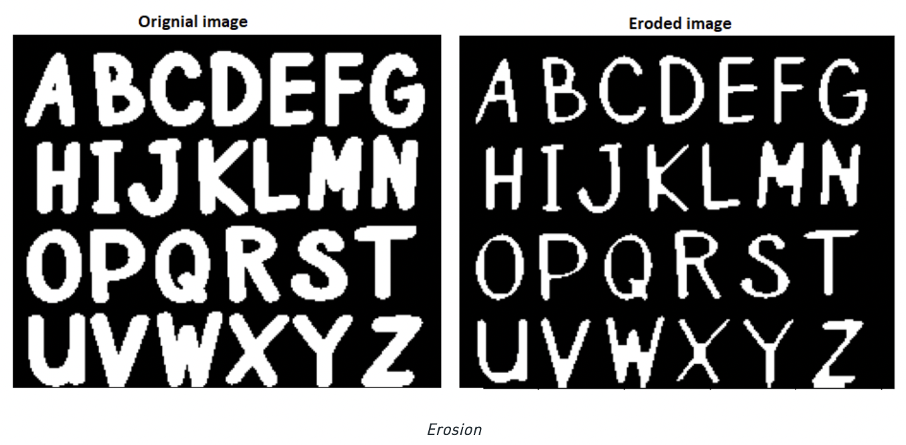
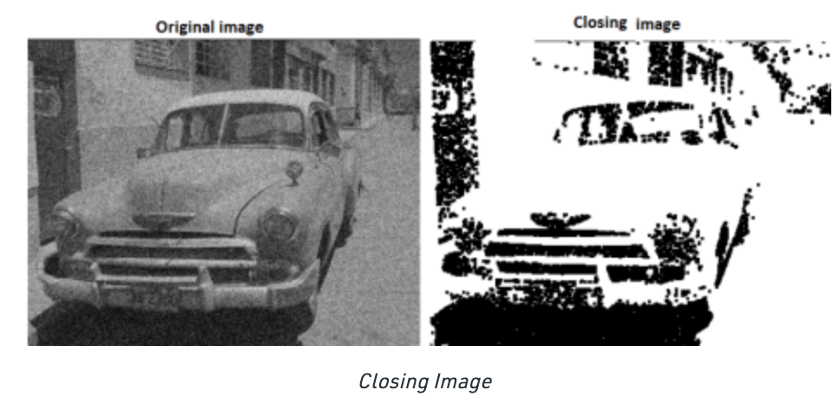

OPENCV
cv2.morphologyEx
cv2.findContours
cv2.approxPolyDP
Erosion
Dilation
Closing
Opening

Slide 6
AIMS
Detect corners of the target paper
Re-project paper for later recognition
Recognize upper and lower cases of 26 letters
Crop them out from the original image and resize them to the same size

Slide 7
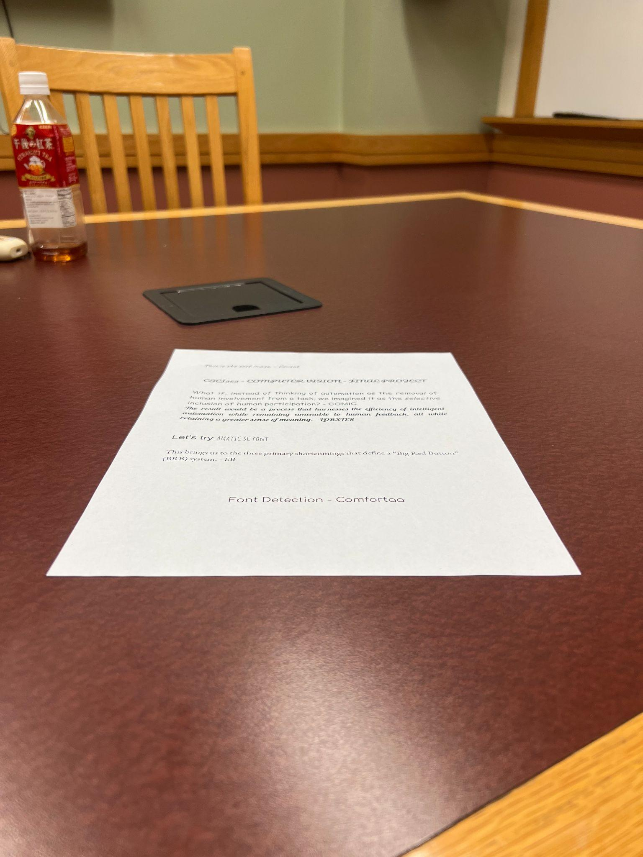
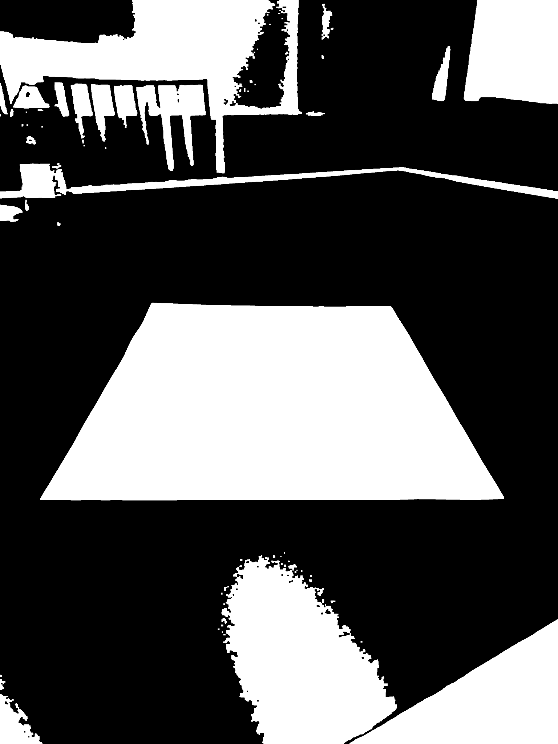
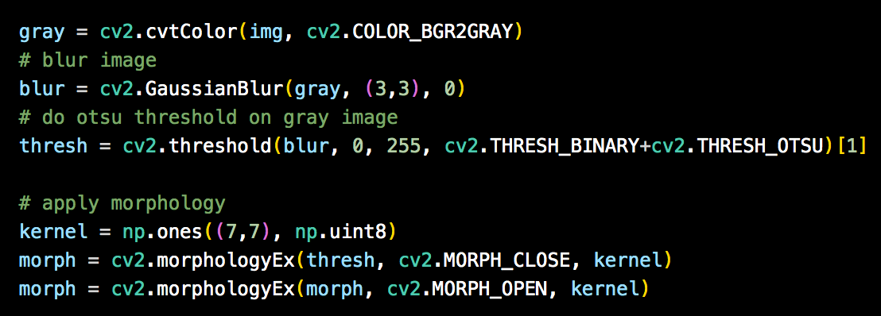
Strategy for Aim#1: Detect corners of the target paper
cv2.morphologyEx
Notes:
Record the steps
Process of thinking
Try - fail - reason - retry

Slide 8
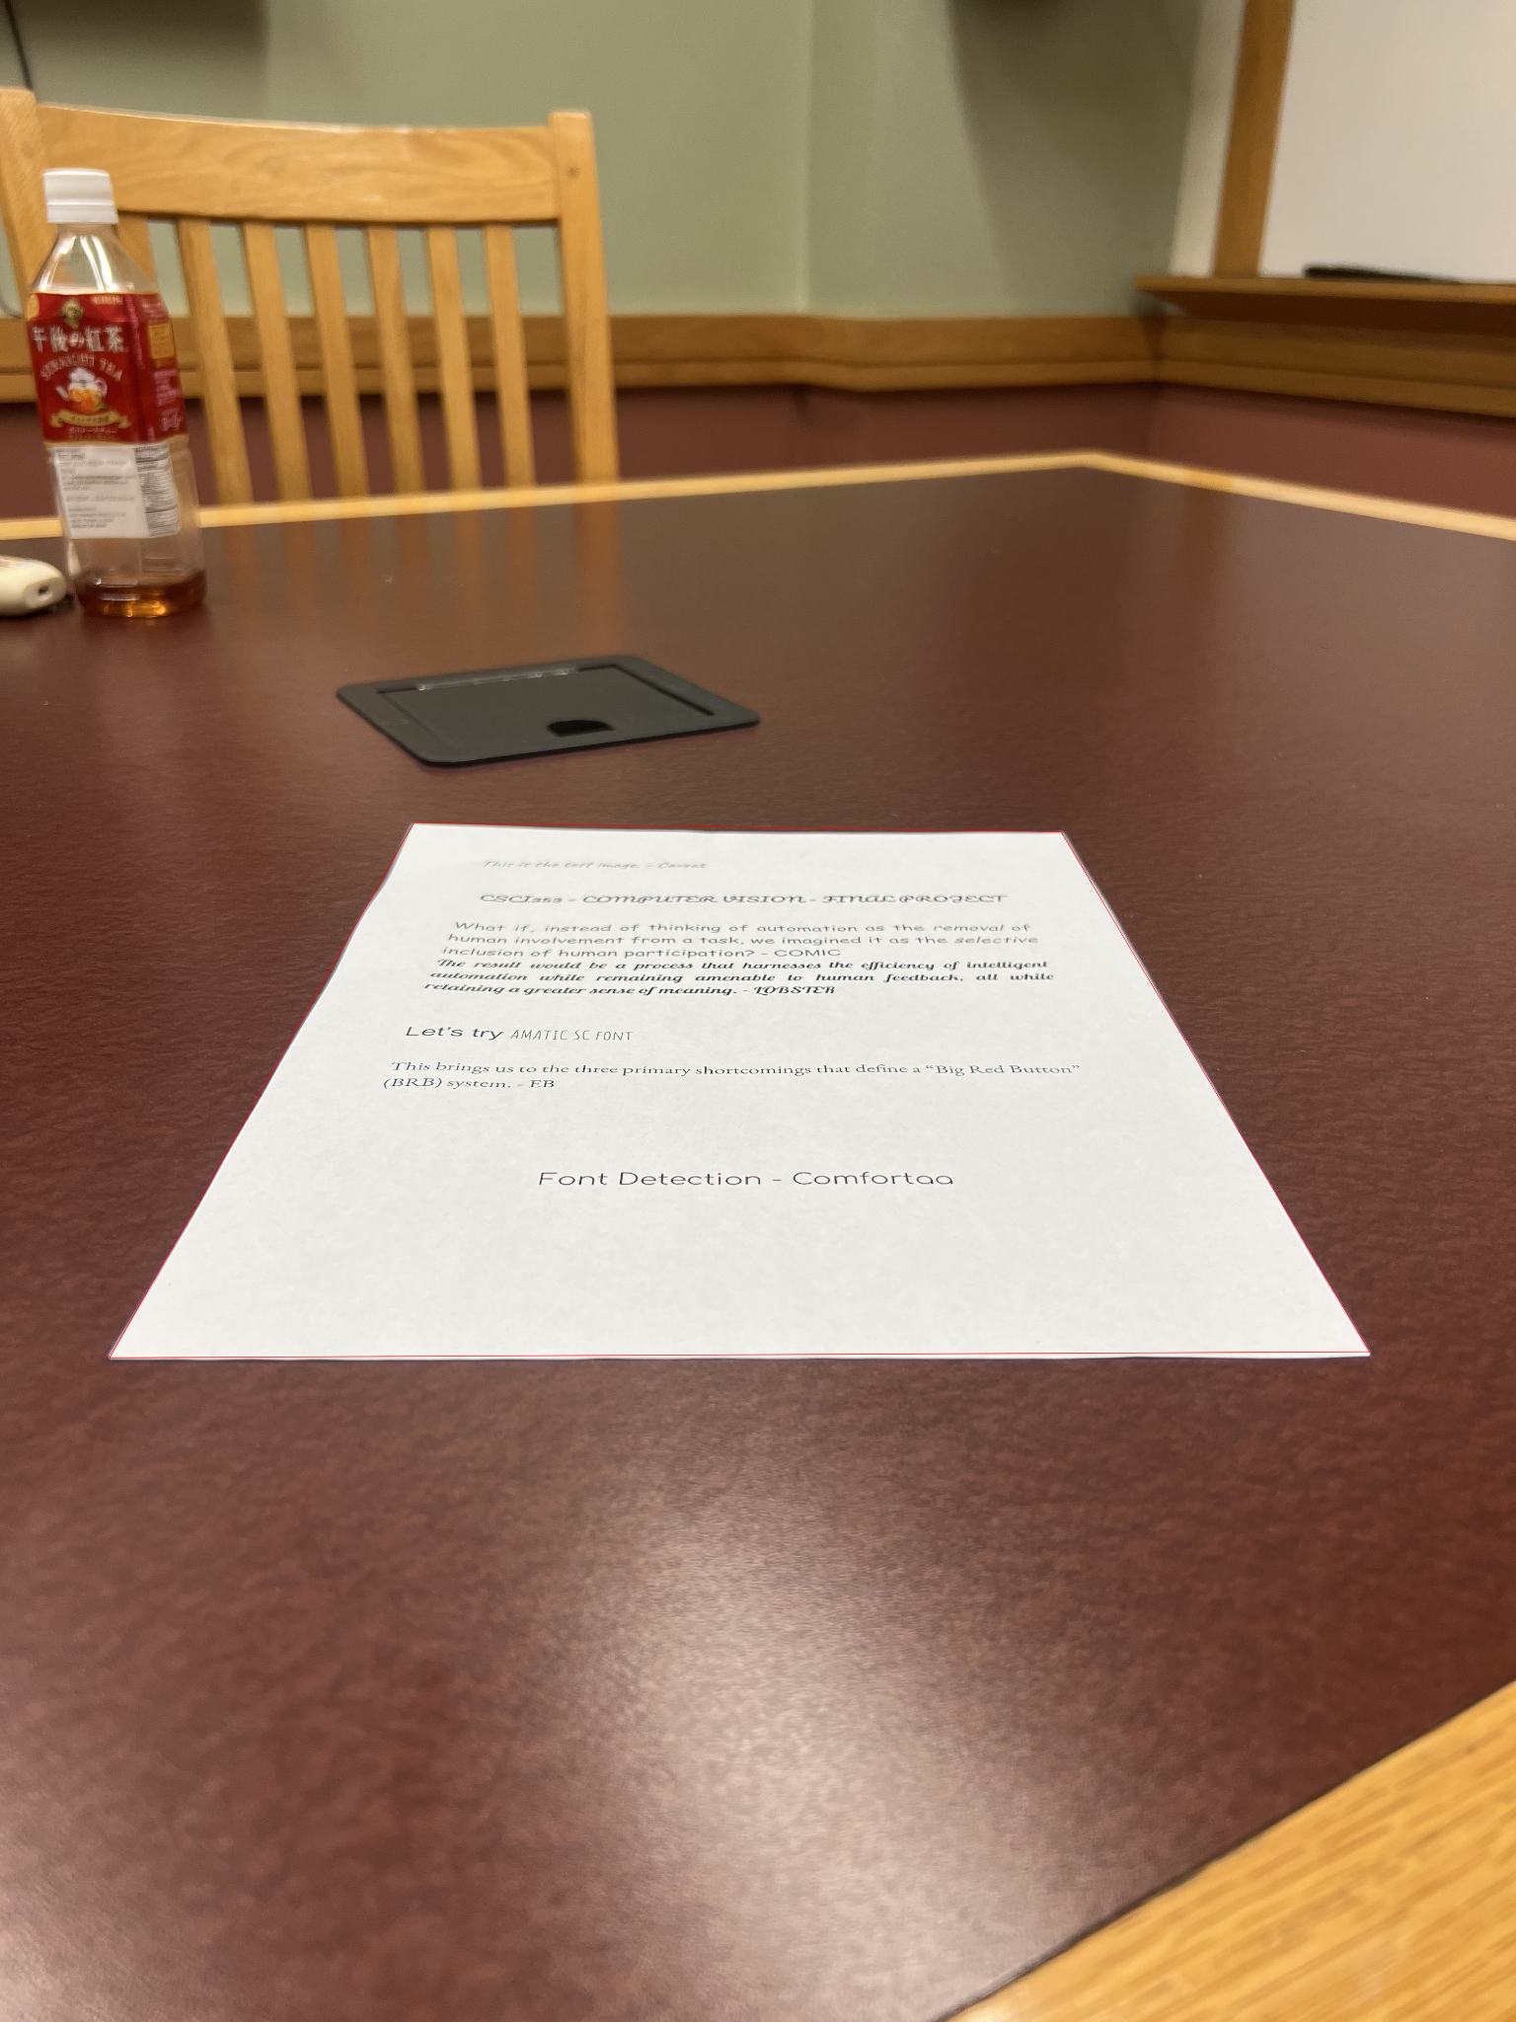
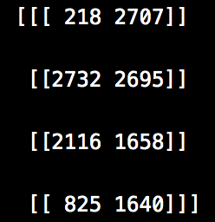
Strategy for Aim#1: Detect corners of the target paper
cv2.findContours
cv2.contourArea
cv2.approxPolyDP

Slide 9
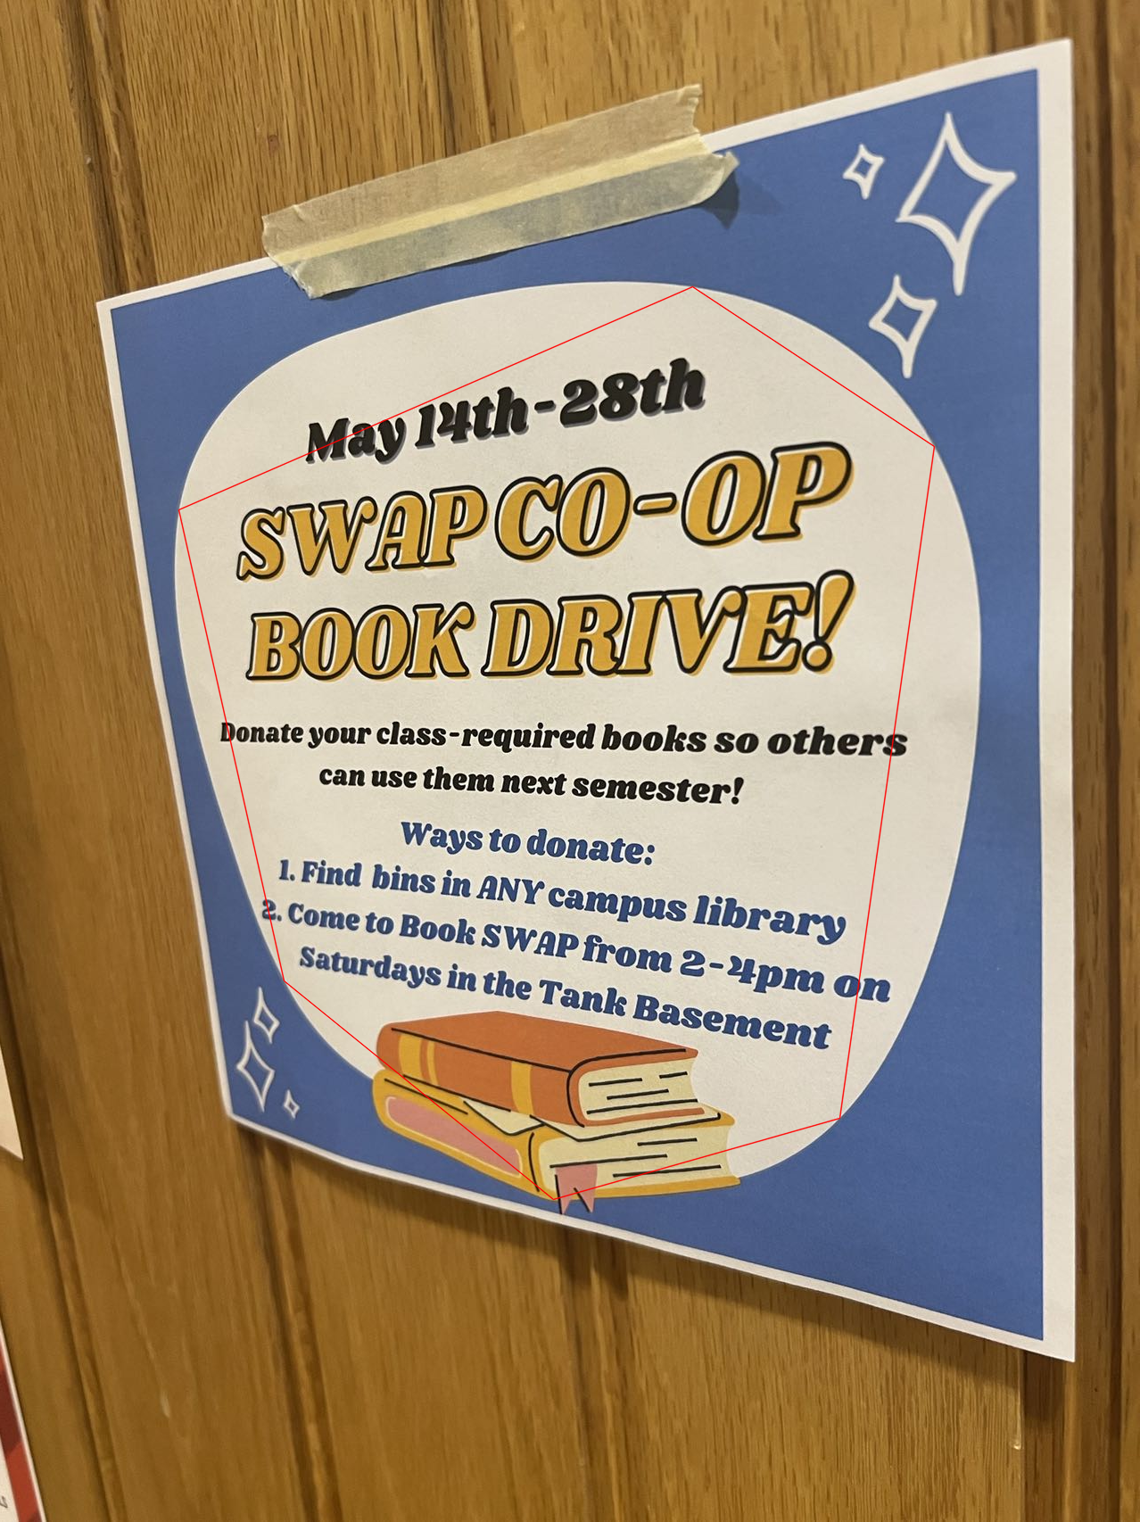
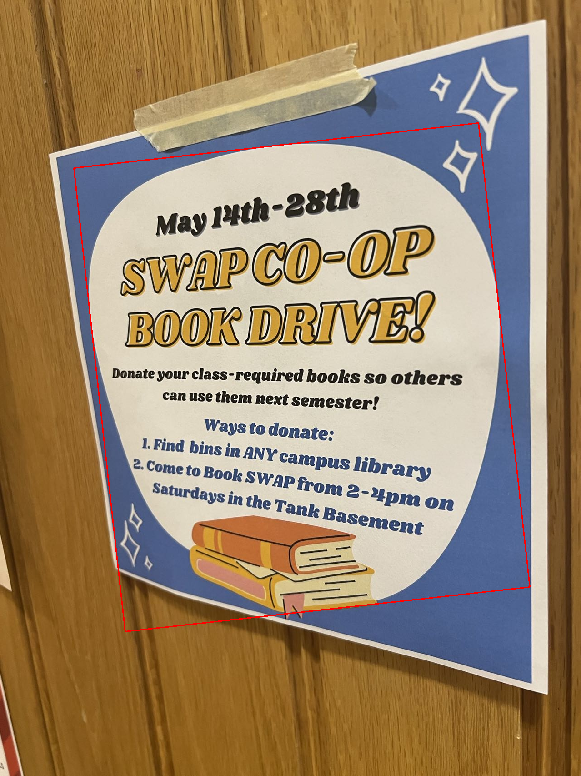
Strategy for Aim#1: Detect corners of the target paper
Notes:
quandrangle

Slide 10
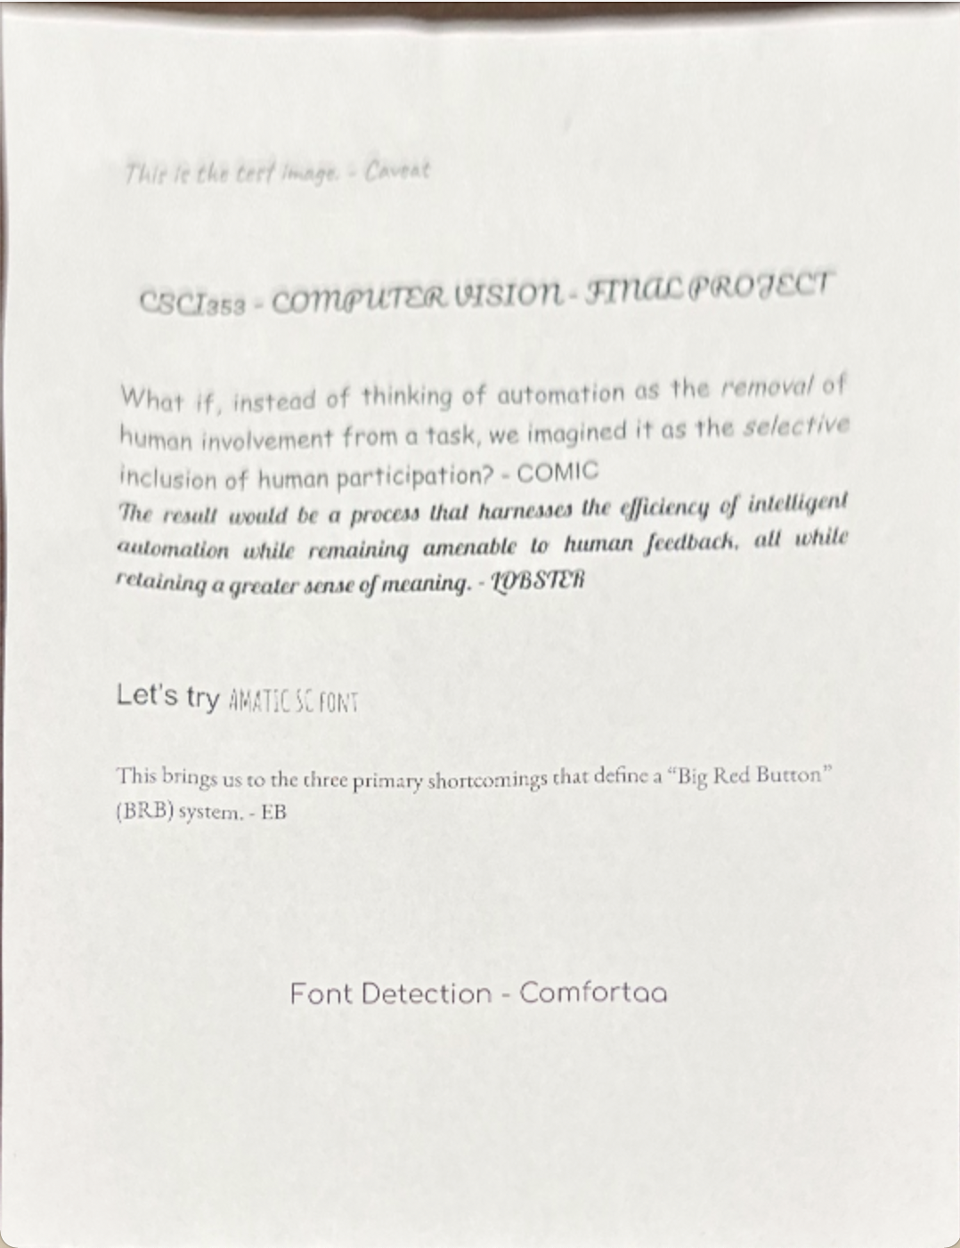
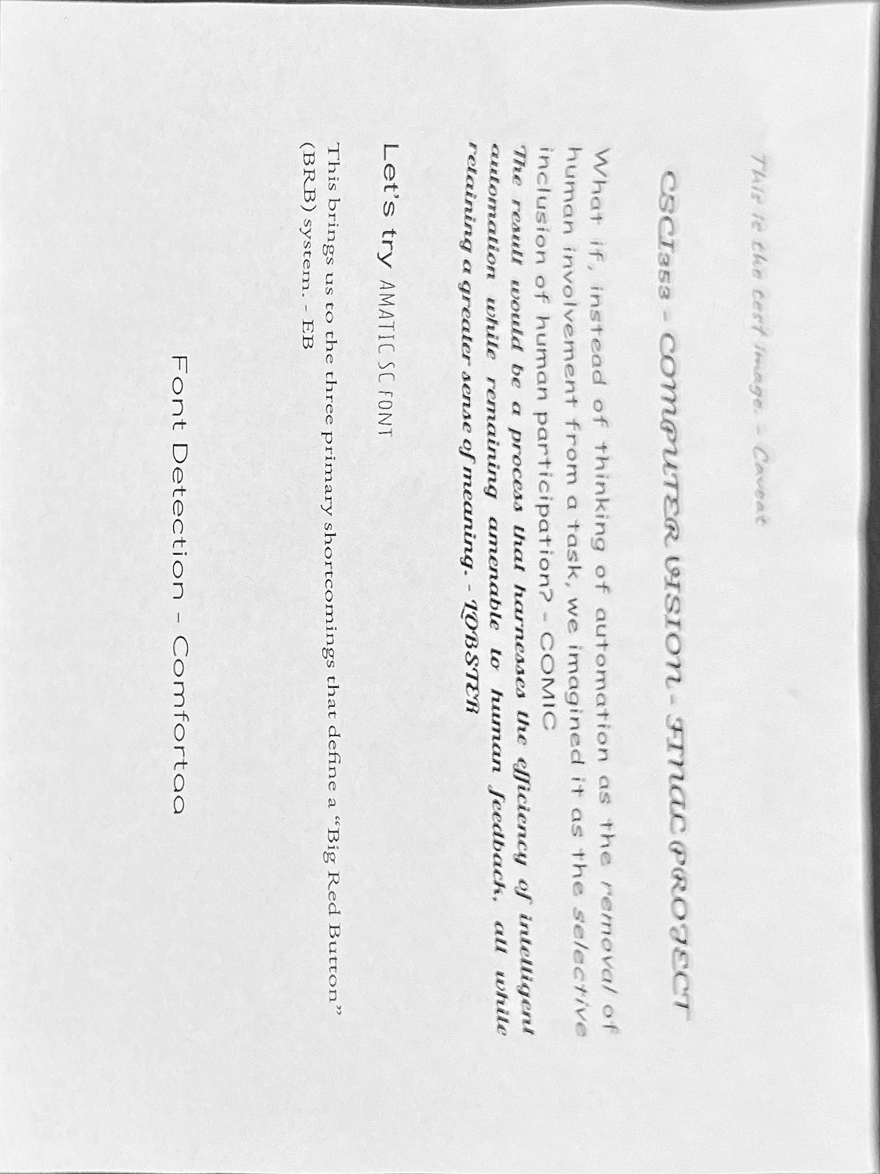
Strategy for Aim#2: Re-project paper for later recognition

Slide 11
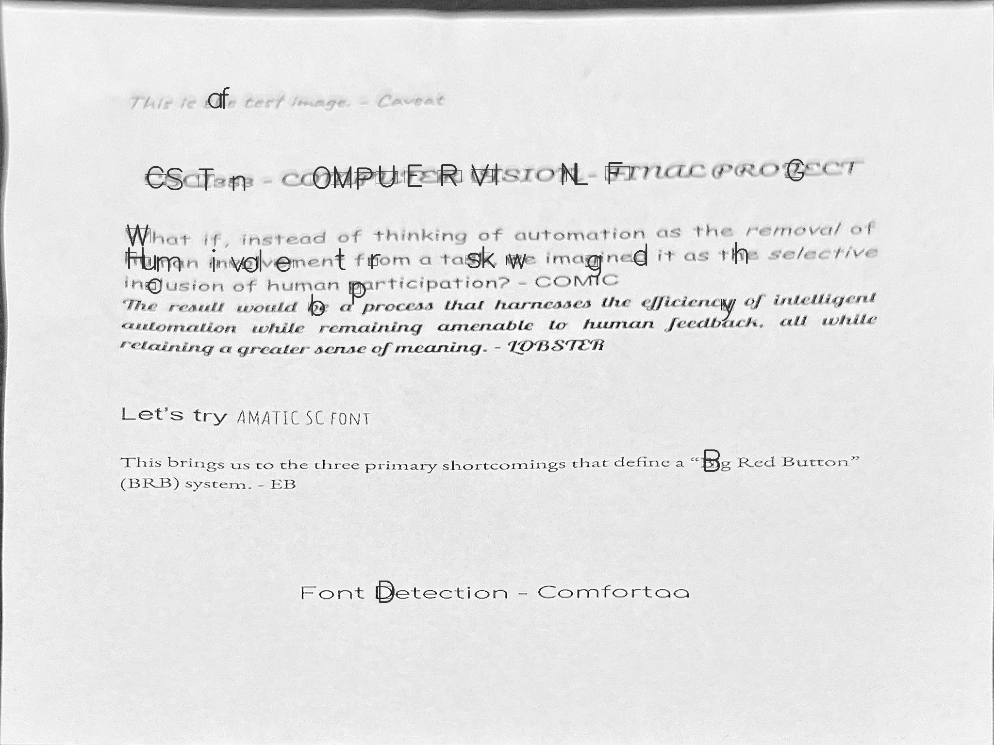
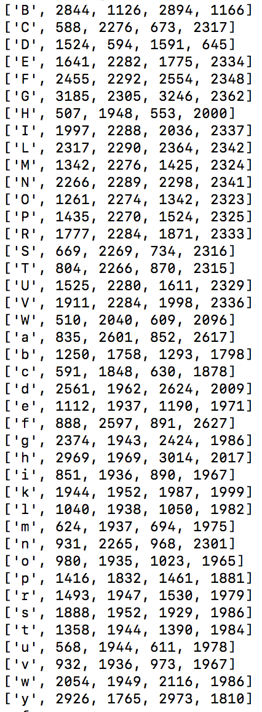
Strategy for Aim#3: Recognize upper and lower cases of 26 letters
pytesseract.image_to_boxes
pytesseract.image_to_string

Slide 12
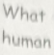
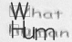
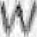
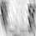


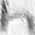
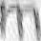


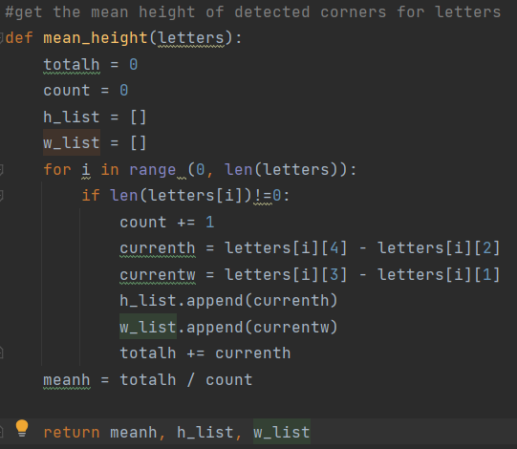
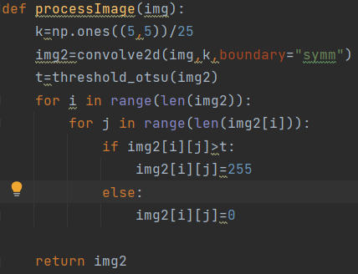
Strategy for Aim#4: Crop and resize
[(hImg - letters[i][4]):(hImg - letters[i][2]),
letters[i][1]:letters[i][3]]

Slide 13
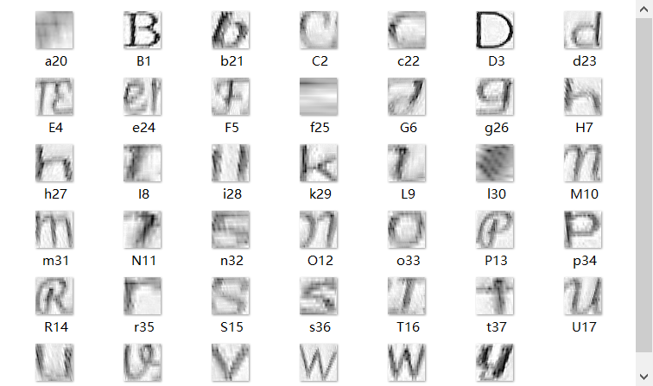
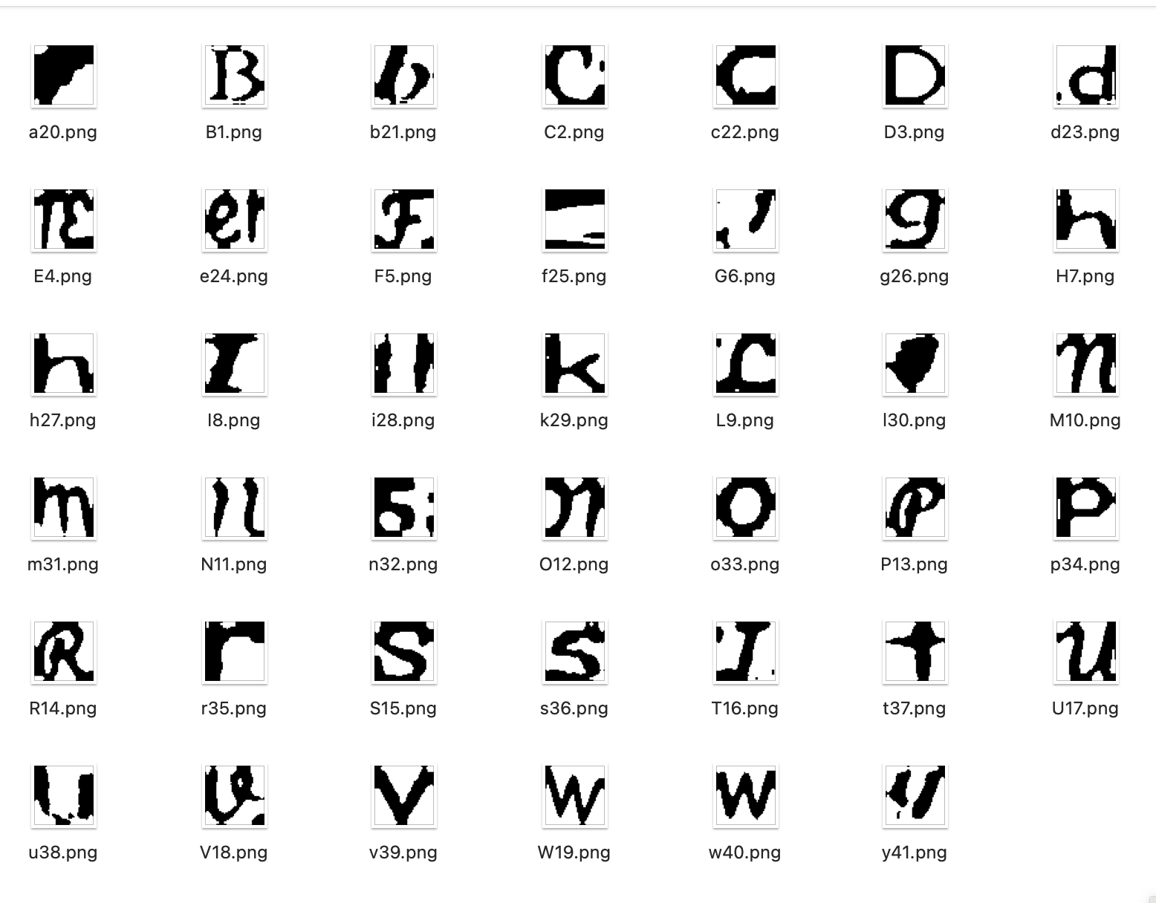
Strategy for Aim#4: Crop and resize

Slide 14
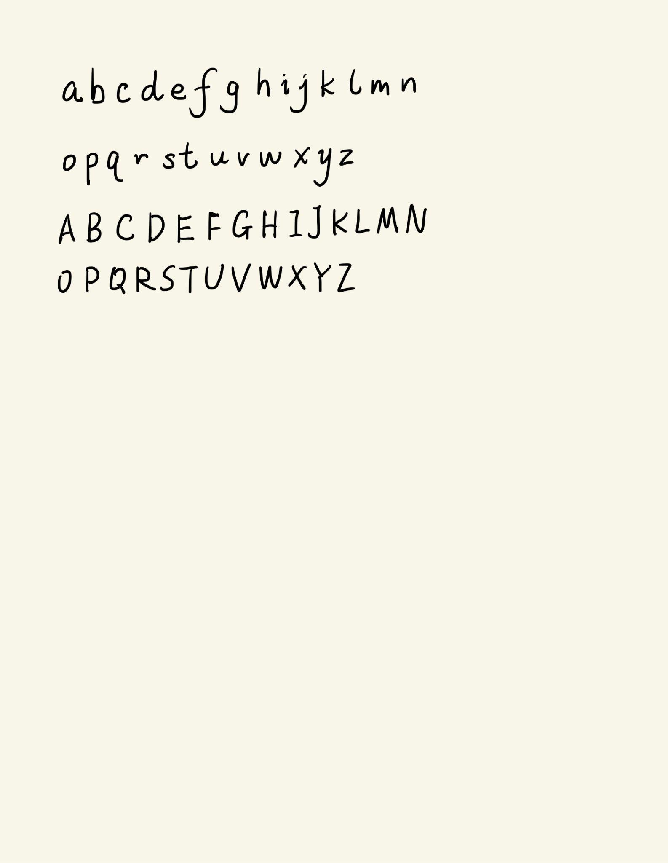
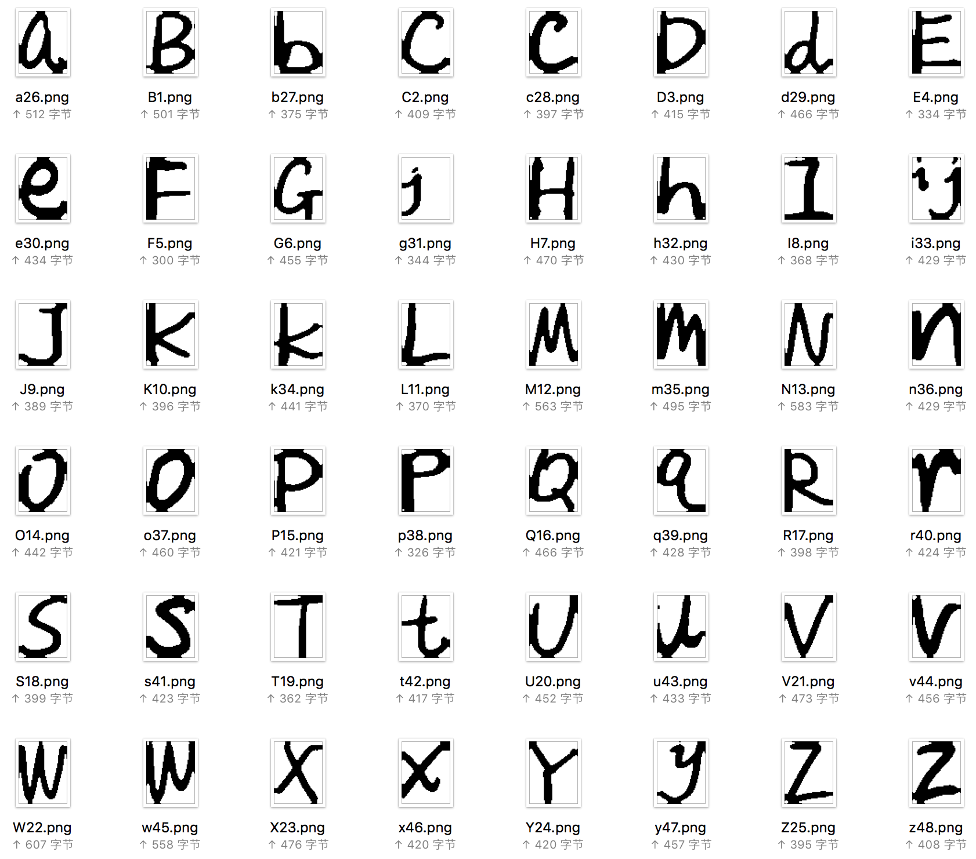
More RESULTS

Slide 15
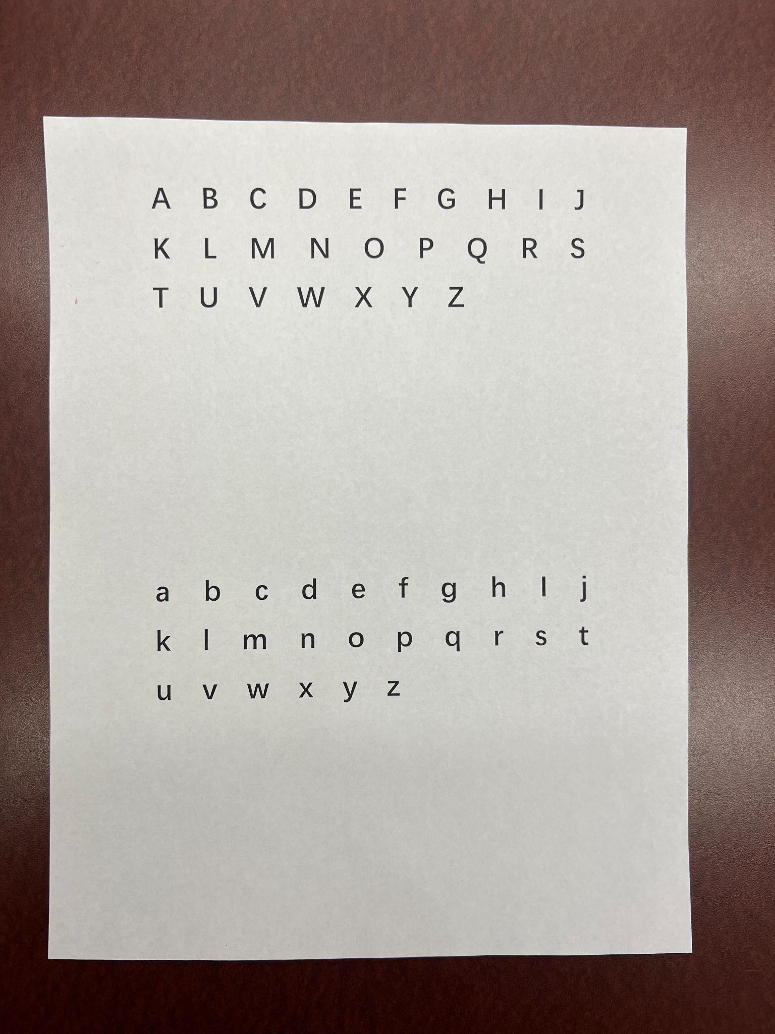
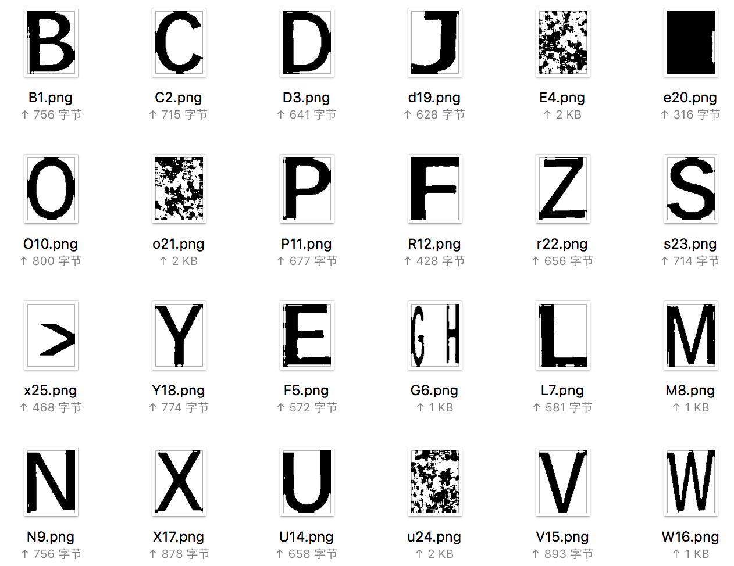
More RESULTS

Slide 16
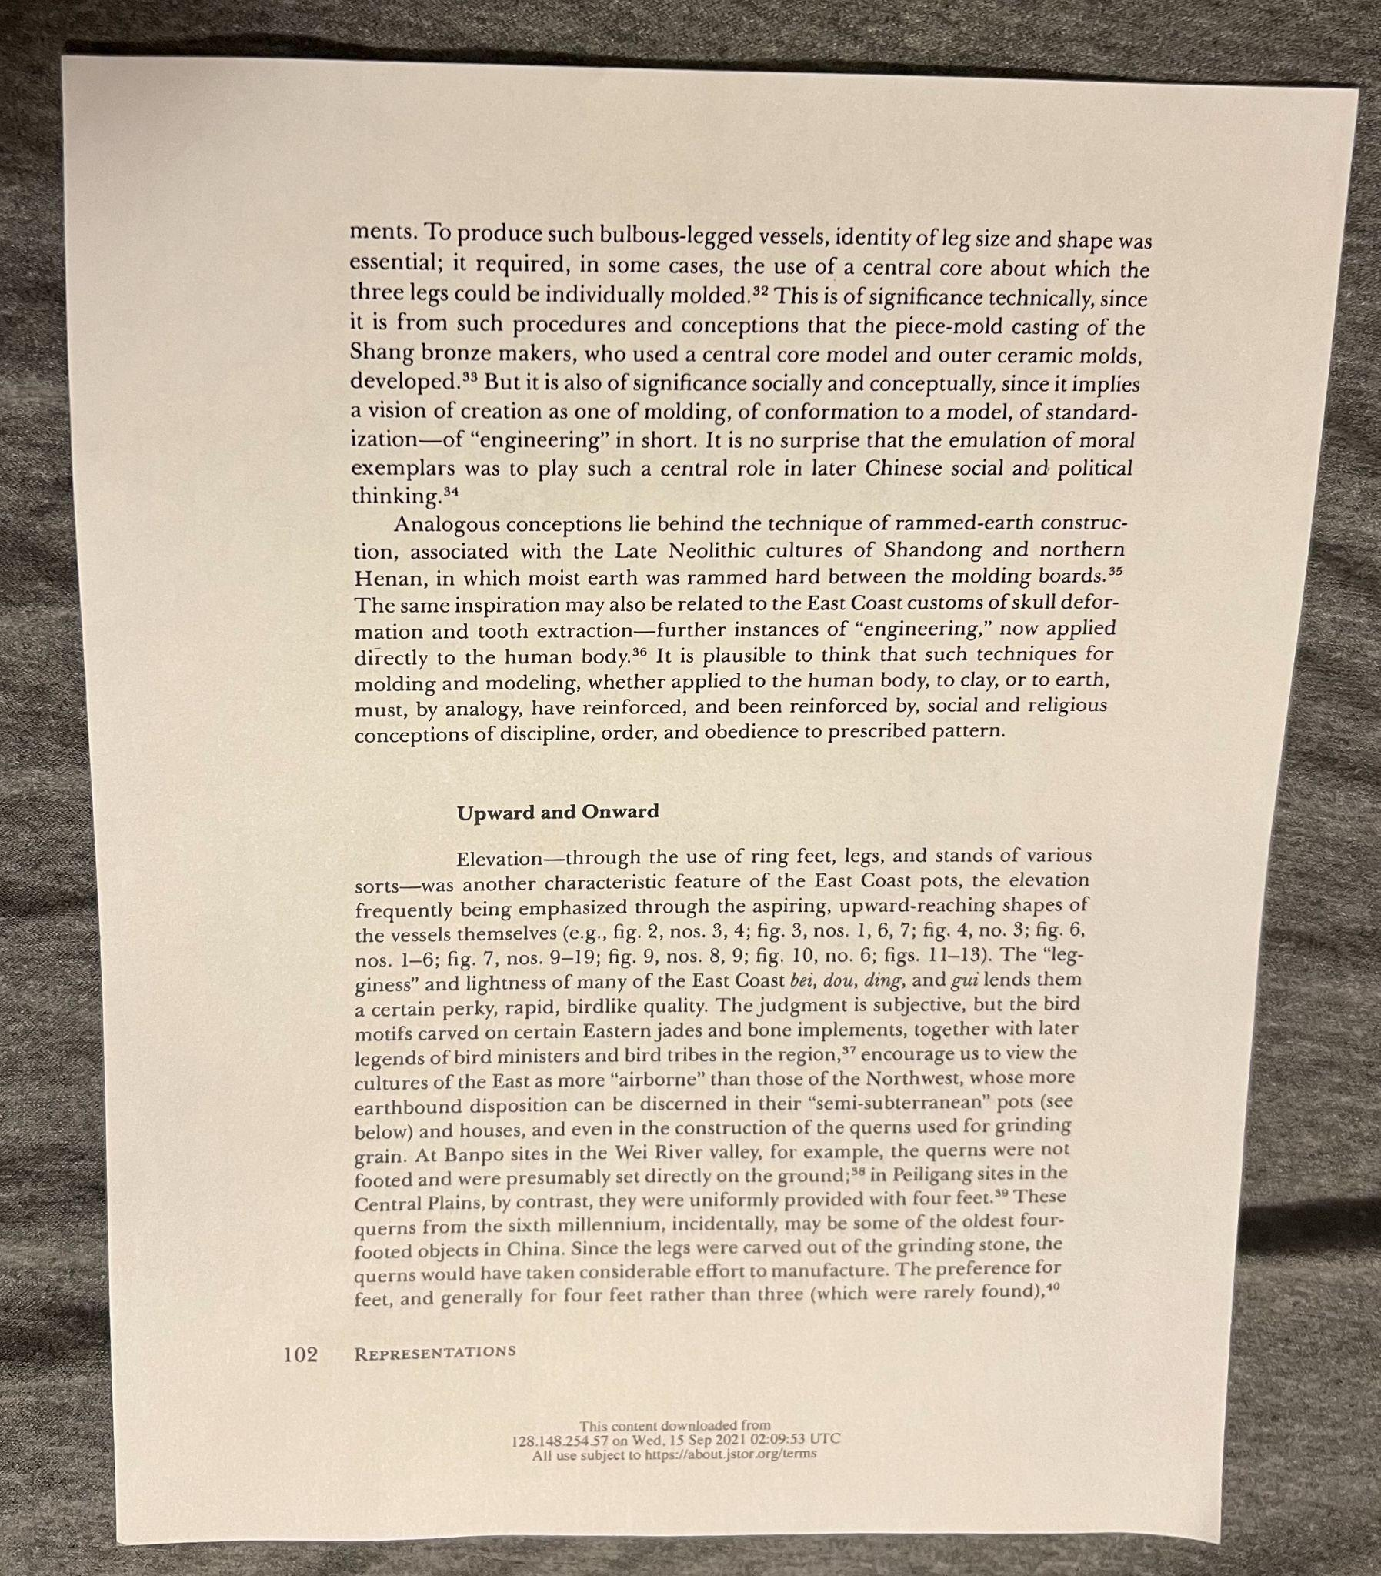
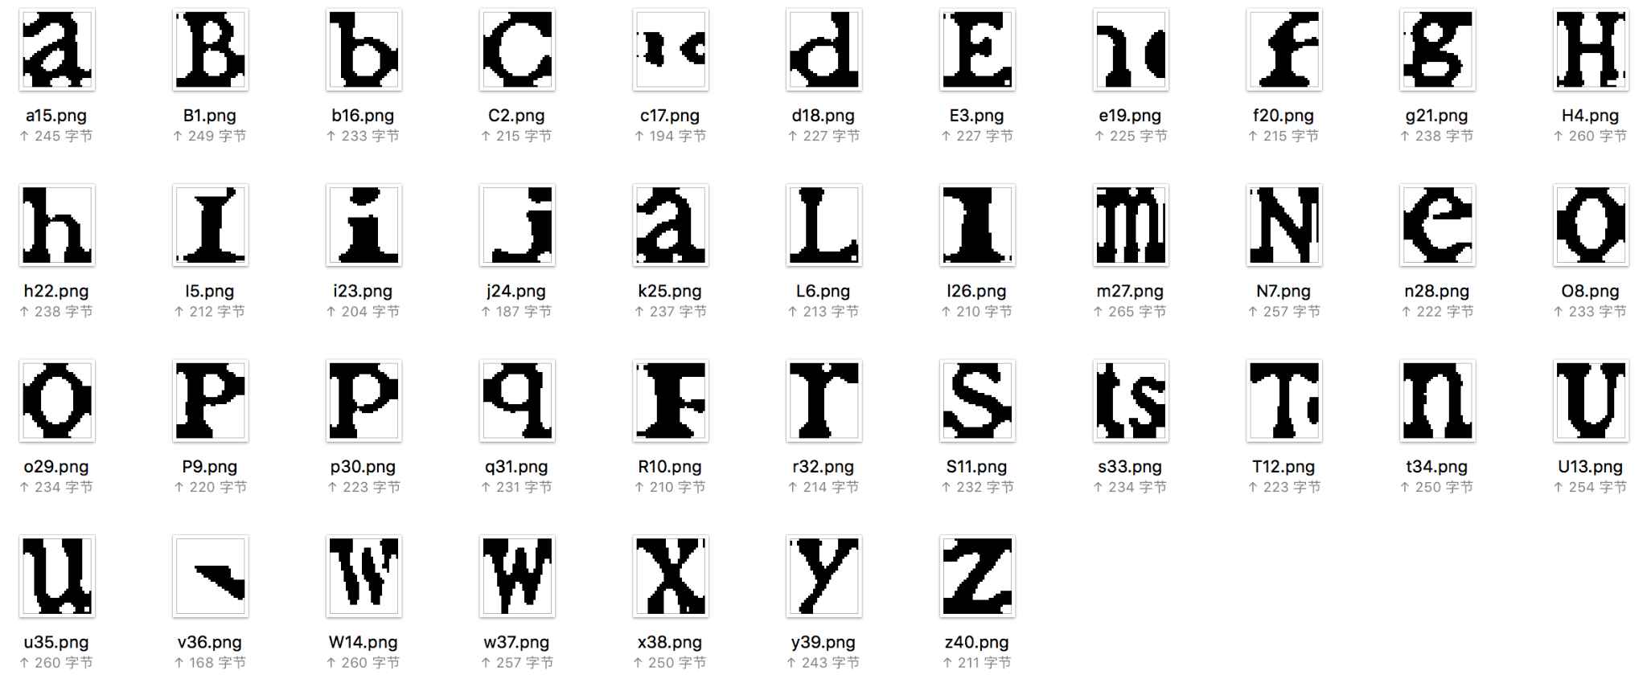
More RESULTS

Slide 17
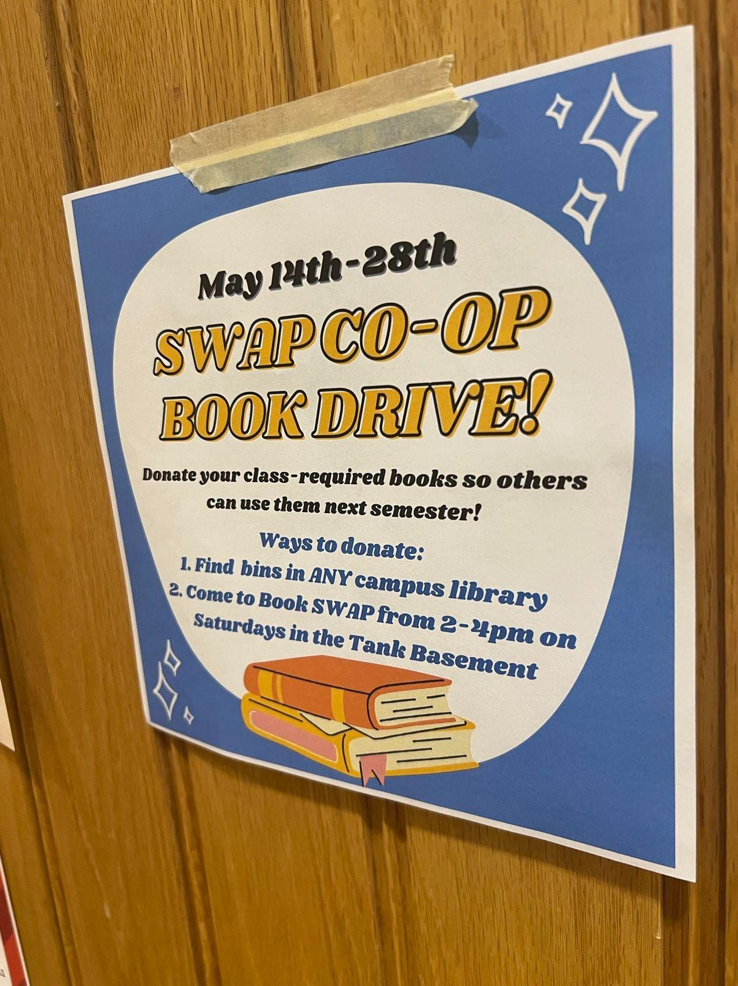
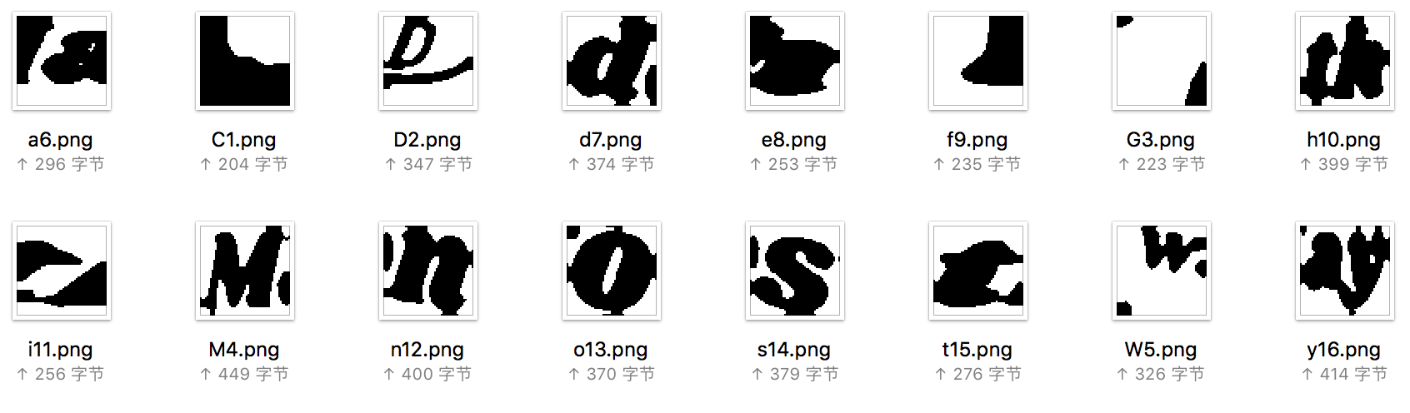
More RESULTS

Slide 18
CONCLUSION
Combination of techniques learned from the class and explore more about skimage & opencv library
Limitations on detection accuracy

Slide 19
FUTURE WORK
Continue increasing the accuracy
Detect the target paper in a messy background
Detect font type of the letters
Transfer letter images into a TTF file

Slide 20
Thank you!

